Slide 1
CORVID- Intelligent Email Processor
Team Members
Lekhnath Bhusal
Madhav Sigdel
Mahesh Raj Regmee
Prajwal Shrestha
Project Supervisors
Jayram Timsina
Ram Govinda Aryal
2007-12-22

Slide 2
Introduction
Corvid is an Email Processing Module. It accounts for email processing for
  Filtration
  Classification
  Summarization of emails.
Each Modules independent.
Integration with Mozilla Thunderbird

Slide 3




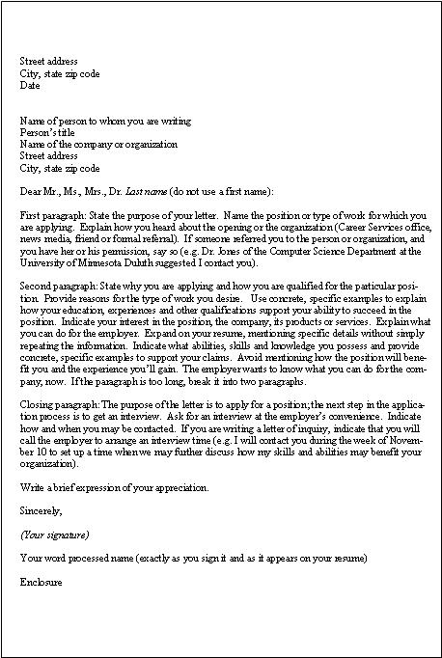
At a Glance
Filtration
Classification
Summarization

Slide 4
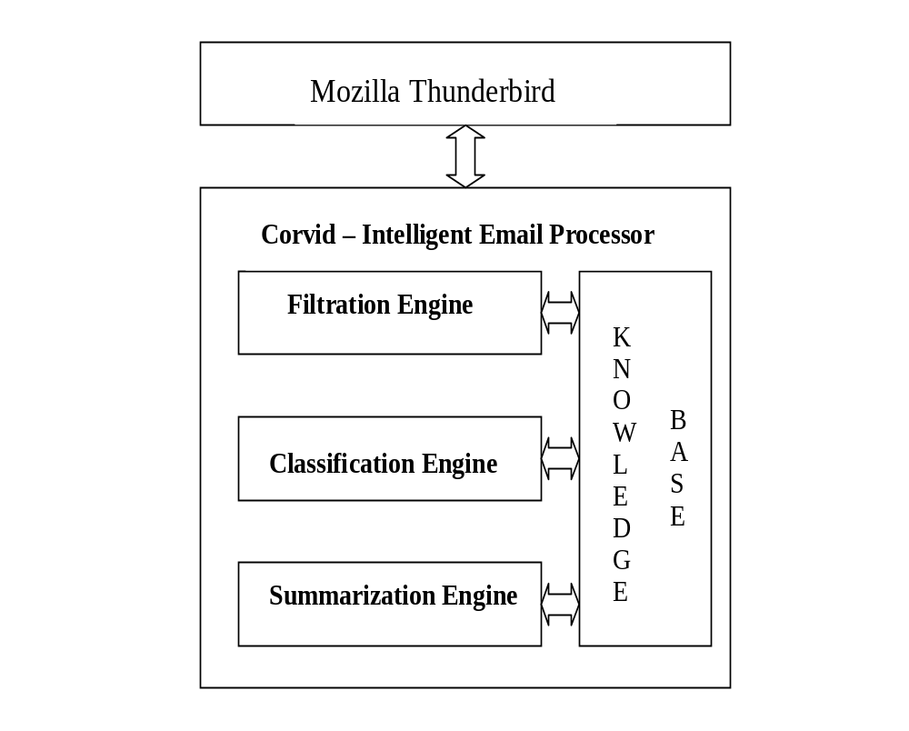
System Architecture

Slide 5
Email Filtration

Slide 6
Filtration Techniques
Rule based filter (Machine learning to email filtration)
Boosting trees for email filtering
Bayesian approach to email filtration
Maximum entropy model for email filtration

Slide 7
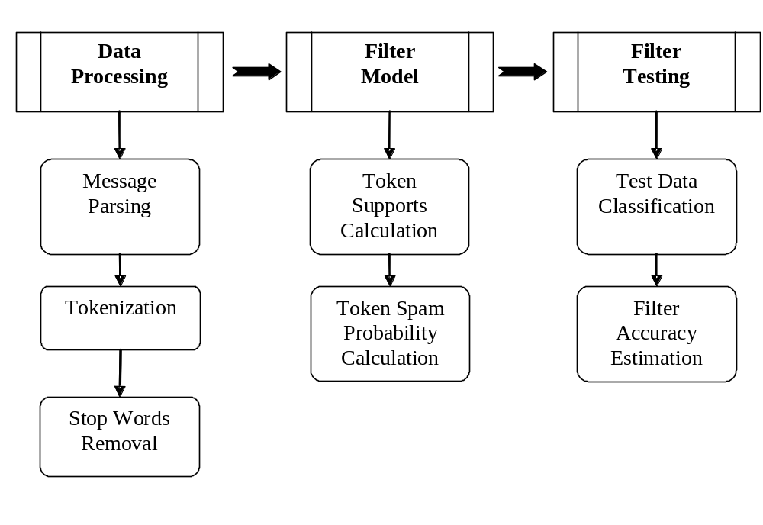
Filter Model

Slide 8
Filtration Tasks : Support Calculation
  Spam email:
  Subject: Congratulations!!!
  Body : you have won a lottery of $25000. Please claim the lottery you have won.
  Ham email:
  Subject: congratulation
  Body: you have been selected for mundus scholarship program.
Item | support
Won | 2
Lottery | 1
Sub: Congratulations!!! | 1
Item | support
Selected | 1
scholarship | 1
Sub: congratulation | 1

Slide 9
Filtration Tasks
Item | probability
Won | 0.9
Lottery | 0.9
Sub.Congratulations!!! | 0.98
  Email:
  Subject: Congratulations!!!
  Body : you have won a lottery.
  Spam probability: 0.99

Slide 10
Email Classification

Slide 11
Classification Algorithms
Naïve bayese classifier
Associative rule based classifier
Adaptive mail classifier
  Totally based on subject content (subject based folders)
Hierarchical email classifier
  Global
  Local

Slide 12
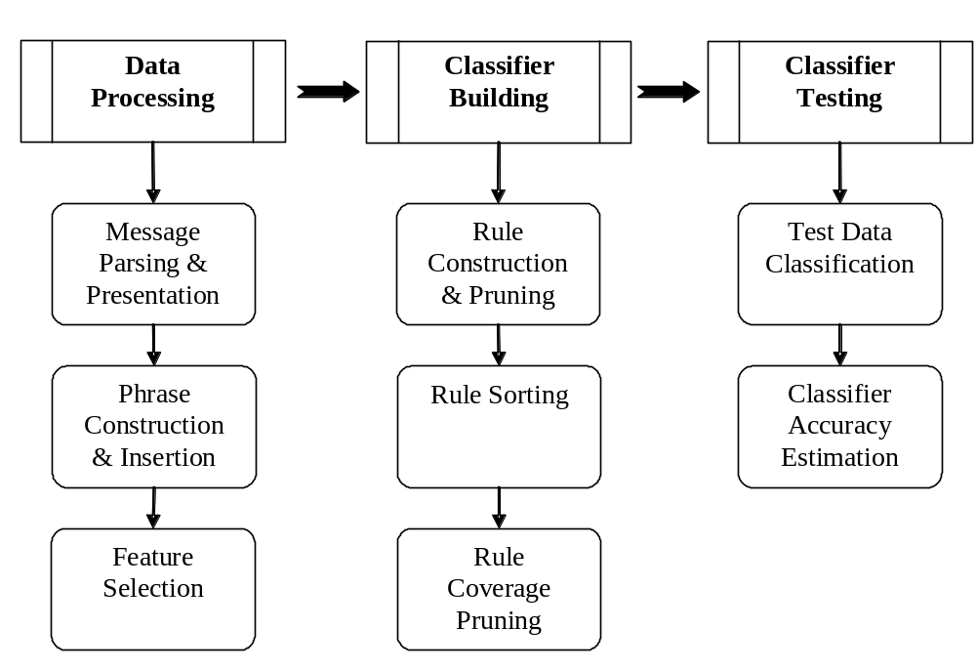
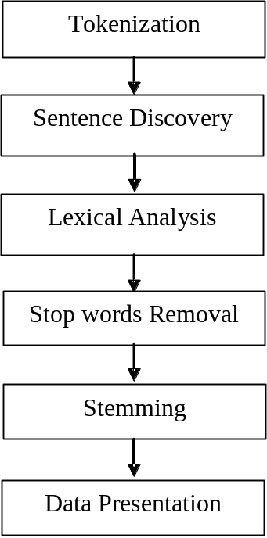
Classification Model

Slide 13
Classification Tasks - Preprocessing
Human Beings are superior to monkeys. Americans think they are superior to Asians.
Tokenization
  Human, Beings, are, superior, to, monkeys,. ,Americans, think, they, are, superior, to, Asians
Sentence Discovery
  Human, Beings, are, superior, to, monkeys,
  Americans, think, they, are, superior, to, Asians

Slide 14
Classification Tasks - Preprocessing
Human Beings are superior to monkeys. Americans think they are superior to Asians.
  Stop words removal
  Human, Beings, superior, monkeys,
  Americans, think, superior, Asians
  Stemming
  Human, Being, superior, monkey,
  America, think, superior, Asia

Slide 15
Classification Tasks - Preprocessing
Human Beings are superior to monkeys. Americans think they are superior to Asians.
Lexical Analysis
hello!->hello,
he!llo->deleted.
Data presentation
Human- 1, Being -2 , superior -3 , monkey -4,
  America -5, think -6, superior -3, Asia -7
1 2 3 4
5 6 3 7

Slide 16
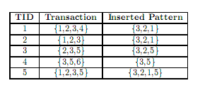
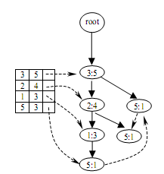

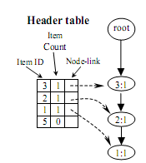

Classification Tasks – Pattern Construction
Final Tree

Slide 17
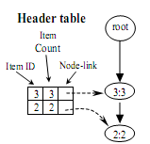
Classification Tasks – Pattern Construction
Lowest frequency item->5
Conditional pattern base of 5:
3 2 1:1
  3:1
3 2:1
Conditional Tree of 5

Slide 18
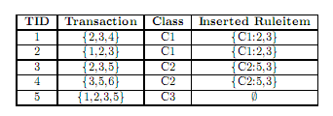
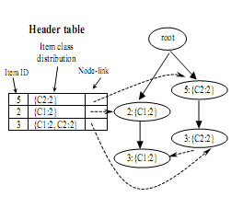
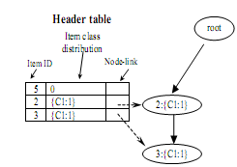

Classification Tasks – Rule Construction

Slide 19
Email Summarization

Slide 20
Summarization Techniques
Clue word summarization
Combining linguistic and machine learning techniques for email summarization

Slide 21
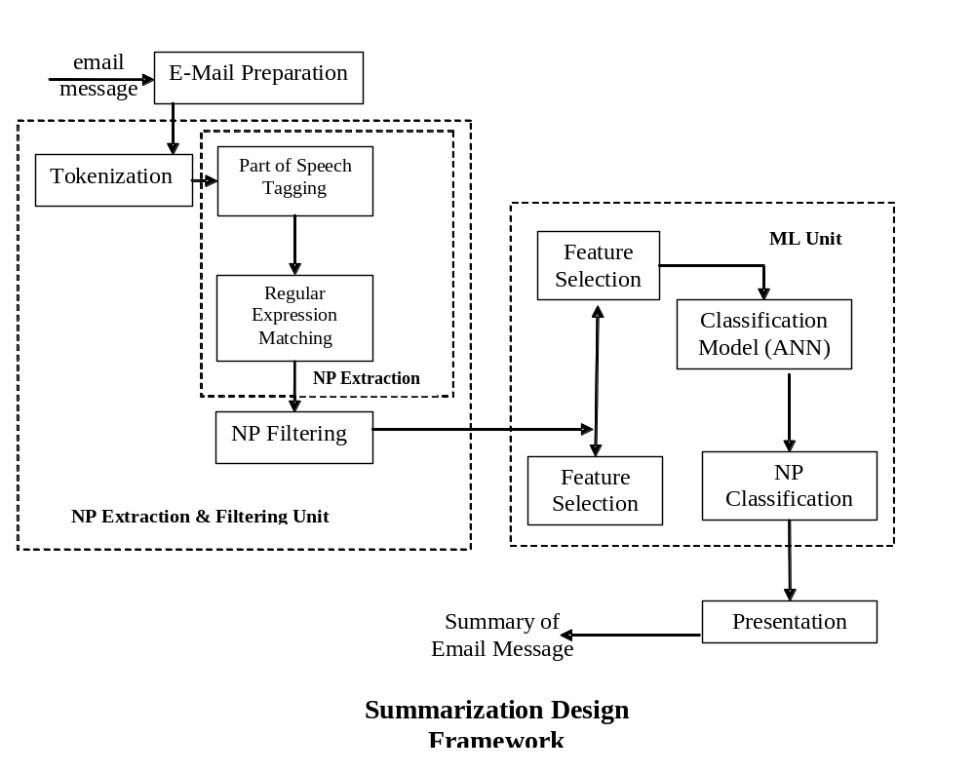
Summarization Model

Slide 22
Summarization Tasks
Preprocessing
  Non-literal character removal
  Tokenization
  Processed Email
POS tagging
  Dictionary Search
  Transformational Rules
Noun phrase extraction
  Data Representation
  Regular Expression Matching
    (Adjective | Noun) * (Noun Preposition)? (Adjective | Noun)* Noun

Slide 23
Contd..
Candidate Noun phrase construction
  Noun Phrase Filtering
Noun Phrase Ranking
  Statistical Feature association such as TFIDF, first occurrence etc.
  Find importance using ANN
Extracting important sentences containing salient noun phrases

Slide 24
Steps
Hello guys,
-- > We’ve the mid-term presentation and demo of our project on 26th december.
-- > Lets integrate all the modules.
Sample Mail
Original Mail
hello guys we’ve the mid-term presentation and demo of our project on 26th december lets integrate all the modules
Tokenization
hello
Hello
hello guys
we’ve the mid-term presentation and
demo of our project on 26th december .
lets integrate all the modules .
Preprocessed Mail

Slide 25
Steps Contd..
hello guys we’ve the mid-term presentation and demo of our project on 26th december .
Lets integrate all the modules .
POS Tagging and
Noun Phrase Extraction
Noun Phrases
    (Adjective | Noun) * (Noun Preposition)? (Adjective | Noun)* Noun
hello guys we’ve – 0.8765
mid-term presentation – 0.92
all the modules – 0.8
Noun Phrase Ranking
we’ve the mid-term presentation and
demo of our project on 26th december
Sentence Extraction

Slide 26
Integration into Mozilla Thunderbird

Slide 27
Tools and Environment
Language
  C++ for building filtration, classification and summarization engine
  JavaScript for event handling
  XUL for User Interface
Tools
  Microsoft Visual Studio – for creating dll file
  Gecko-SDK – for integration of modules in Mozilla Thunderbird
  Mozilla Firefox for User Interface Testing

Slide 28
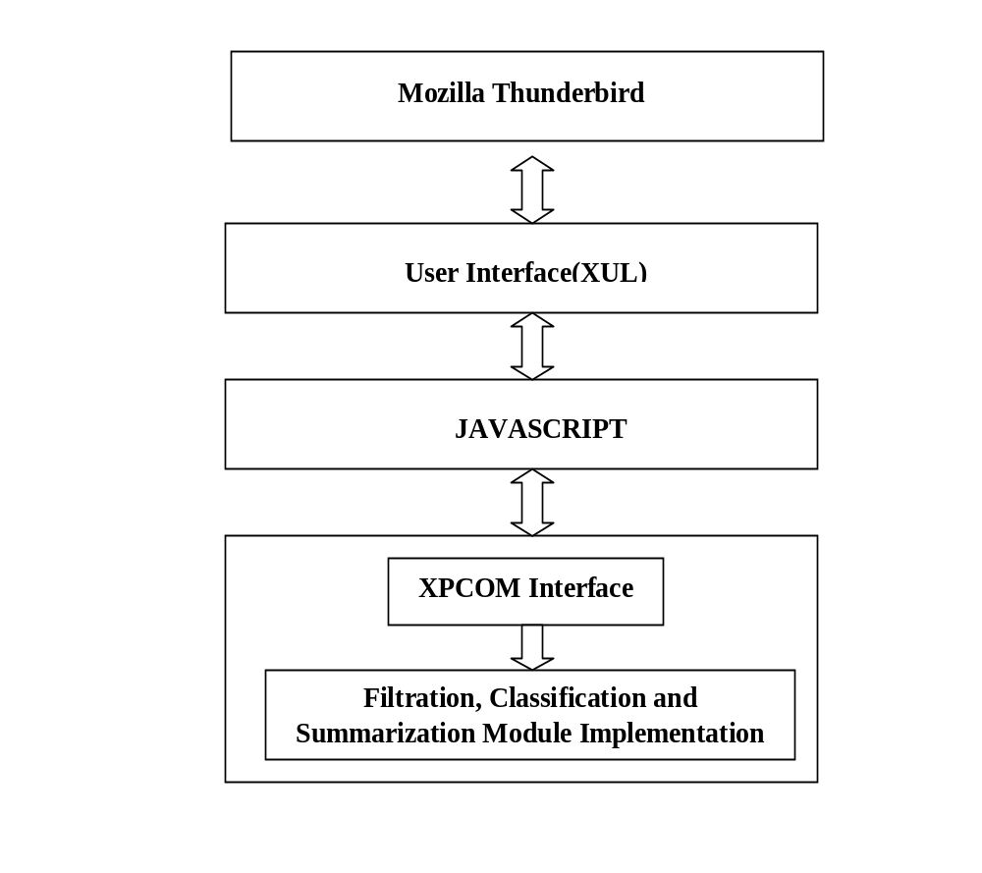
Interfacing Model

Slide 29
Integration Tasks
Create XPCOM Component
  Interface using xpidl
  Typelib and header file using gecko-sdk
  DLL using visual studio
Register component
Script and overlay
  Interaction with Mozilla components and interfaces

Slide 30
Extension Folder Structure
Corvid/
chrome. Manifest
install.rdf
install.js
content/
javascript and XUL files
components/
DLL modules
locale/
en-US/
DTD files
skin/
CSS files

Slide 31
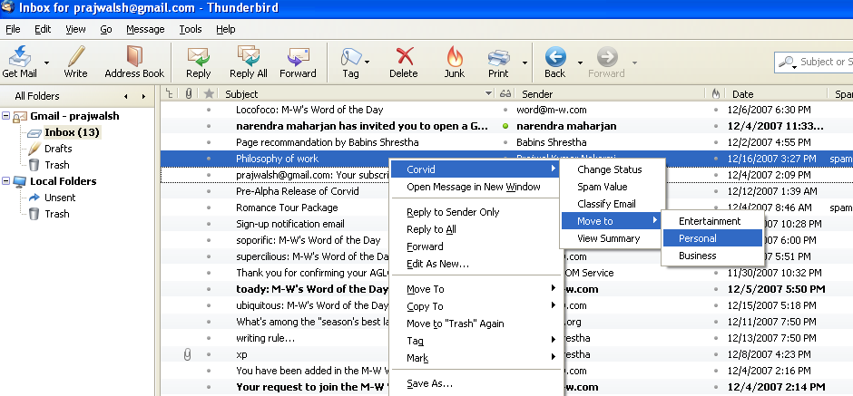
A Glimpse of Current work

Slide 32
Remaining Tasks
User Interface
  Preferences
  Result Storage
Performance Enhancement
  Accuracy
  Efficiency
Testing

Slide 33
References
Julia Itskevitch, Belorussian, Automatic Email Classification using Association Rules. State Polytechnic Academy, 1997
Smaranda Muresan, Evelyne Tzoukermann, Judith L. Klavans, Combining Linguistic and Machine Learning Techniques for Email Summarization
John Graham-Cumming, Three years of Spam Mutation. In the Proceedings of The Spammer’s Compendium, January 2003
Creating C++ XPCOM components, Alex Sirota

Slide 34
Thank You
Any Queries\Suggestions\Comments
are welcome

